Slide 1

Welcome
Presenter: Daniel Mejia

Slide 2
0.27 Fatal Accident Per million
Plane Accidents are rare.
Out of 40 accidents, 5 were fatal (1).
There is an accident every 3.7 million flies.

Slide 3
My Data
Similar trends were found and confirmed.
Data shows accidents have continued to decrease over the years.

Slide 4
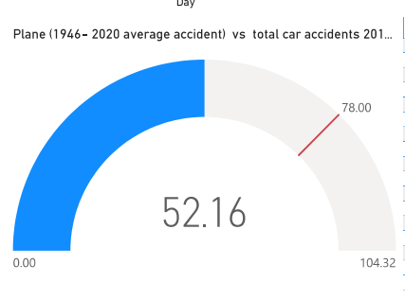
The Average of planes fatalities from 1940 – 2020 is still lower than a year data of car crashing.

Slide 5
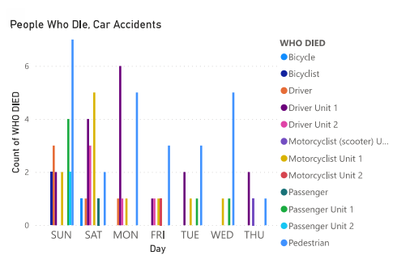
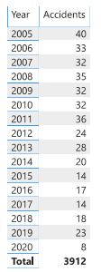
Car Crashes Vs Planes
Just on a Sunday, there are more crashes than the entire year for airplanes.

Slide 6
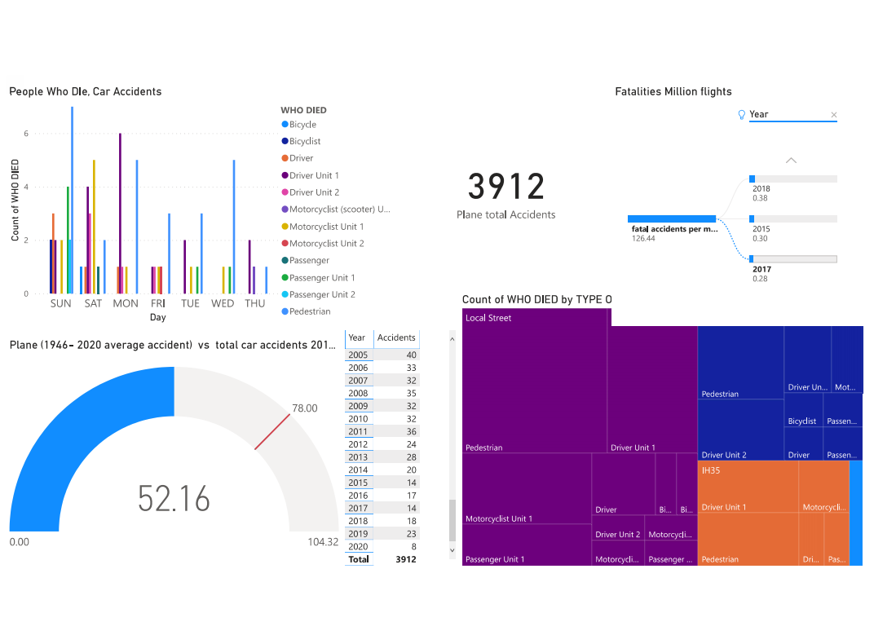
The Graph contain more detailed information, specifying planes and car crashes in more details.
Bicyclist are one of the biggest problems in car crash.
The total plane crashes since 1940 is 3910. This is a small number.

Slide 7
Planes Prove to be safer than car by all the data available.

Slide 8

Reference
Reporter, G. S. (2021, January 2). Plane crash deaths rose in 2020 despite pandemic. The Guardian. https://www.theguardian.com/world/2021/jan/02/plane-crash-deaths-rose-in-2020-despite-pandemic

